Slide 1


Empowering Educators: Enhancing Practice Through Professional Learning

Slide 2

Rethinking Professional Development
Traditional Model:
One-size-fits-all approach: Workshops and seminars. Limited impact on classroom
practice.
Paradigm Shift:
Customized approach tailored to individual needs.
Emphasis on practical application in the classroom.

Slide 3

The Case for Professional Learning
Professional Learning is a philosophy centered on continuous growth and collaboration and tailored to teachers' needs and goals. It offers an ongoing journey of learning.

Slide 4
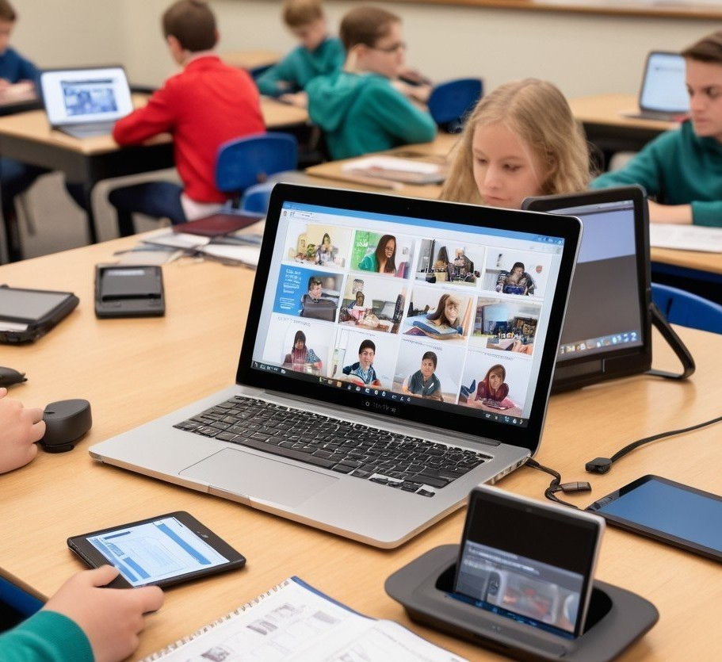
Understanding Blended
Learning and Diffrentiation
Blended Learning integrates technology with personalized instruction, offering a dynamic educational approach. By combining traditional teaching methods with digital tools, it caters to the diverse needs of students, allowing for individualized learning experiences. This approach empowers teachers to create engaging and interactive lessons that foster more profound understanding and student engagement, ultimately leading to more effective learning outcomes.

Slide 5

Benefits of Professional Learning
Customization to match unique teaching styles.
Sustainability leading to long-lasting
changes.
Collaboration through Professional Learning communities.
Improved student outcomes by meeting
diverse learner needs.

Slide 6

5 Effective Principles of Effective Professional Learning
Duration Support Engagement Model
Content Specific

Slide 7

Duration
Ensure professional learning is substantial and continuous to provide ample time for teachers to master new strategies and tackle implementation challenges confidently. Continuous support is
essential.

Slide 8

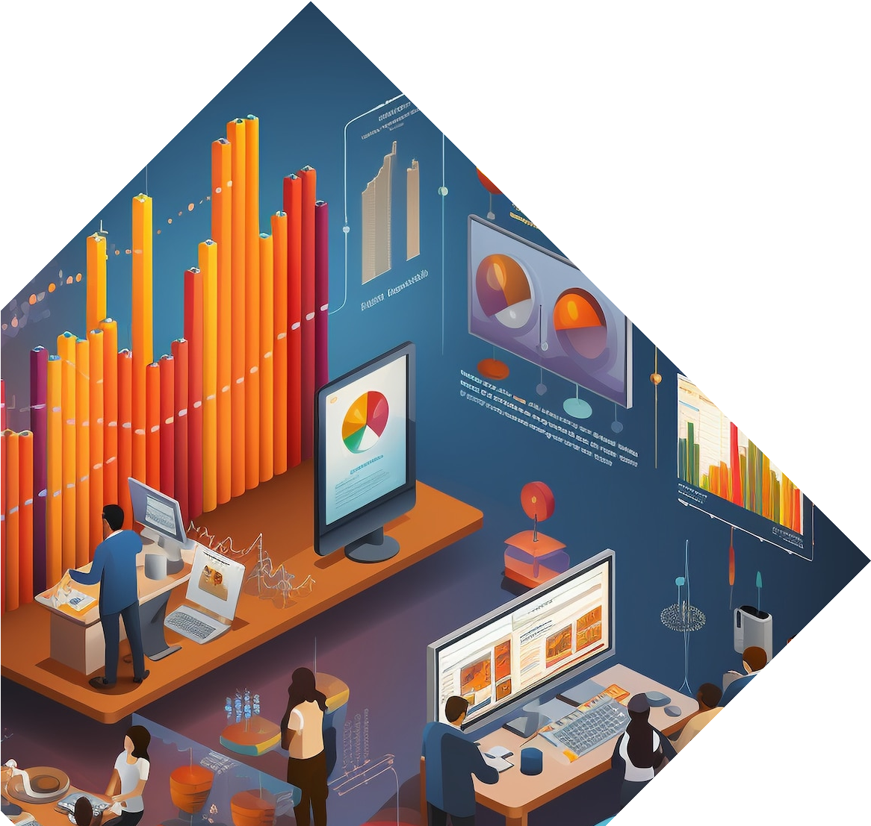
Support
Support for teachers during the implementation stage is essential to effectively address the specific challenges of changing classroom practice.

Slide 9

Engagement
Rephrase the content by confidently involving teachers in various approaches to actively engage them in grasping new concepts, instead of simply presenting the concepts
passively.

Slide 10
Modeling
Modeling significantly enhances educators' comprehension of a novel teaching approach.

Slide 11
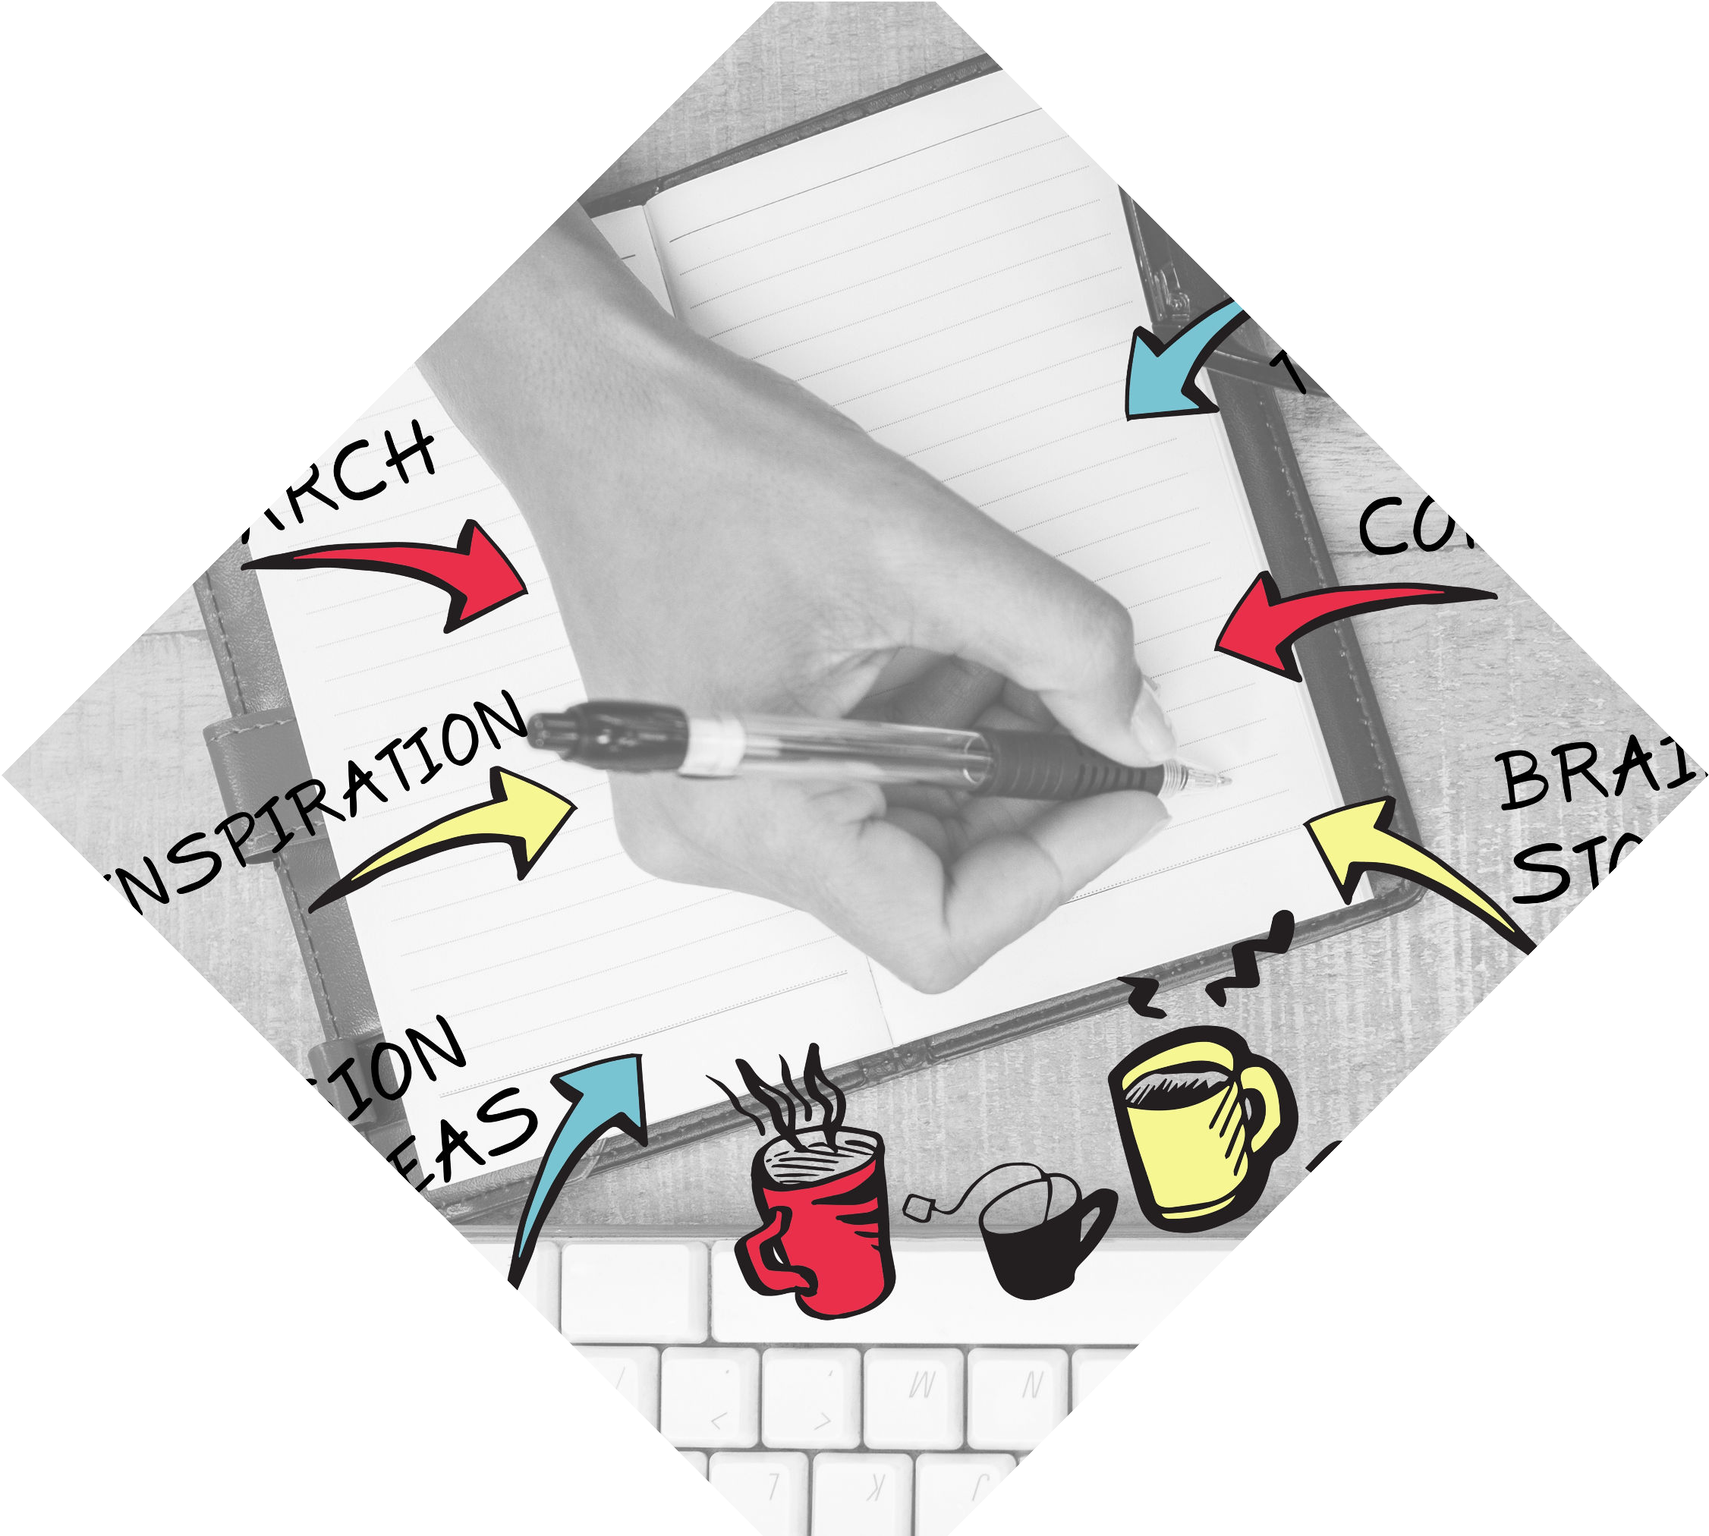
Content Specific
The material for teachers should be tailored to their subject area (for middle and high school educators) or grade level (for elementary teachers), rather than generic.

Slide 12
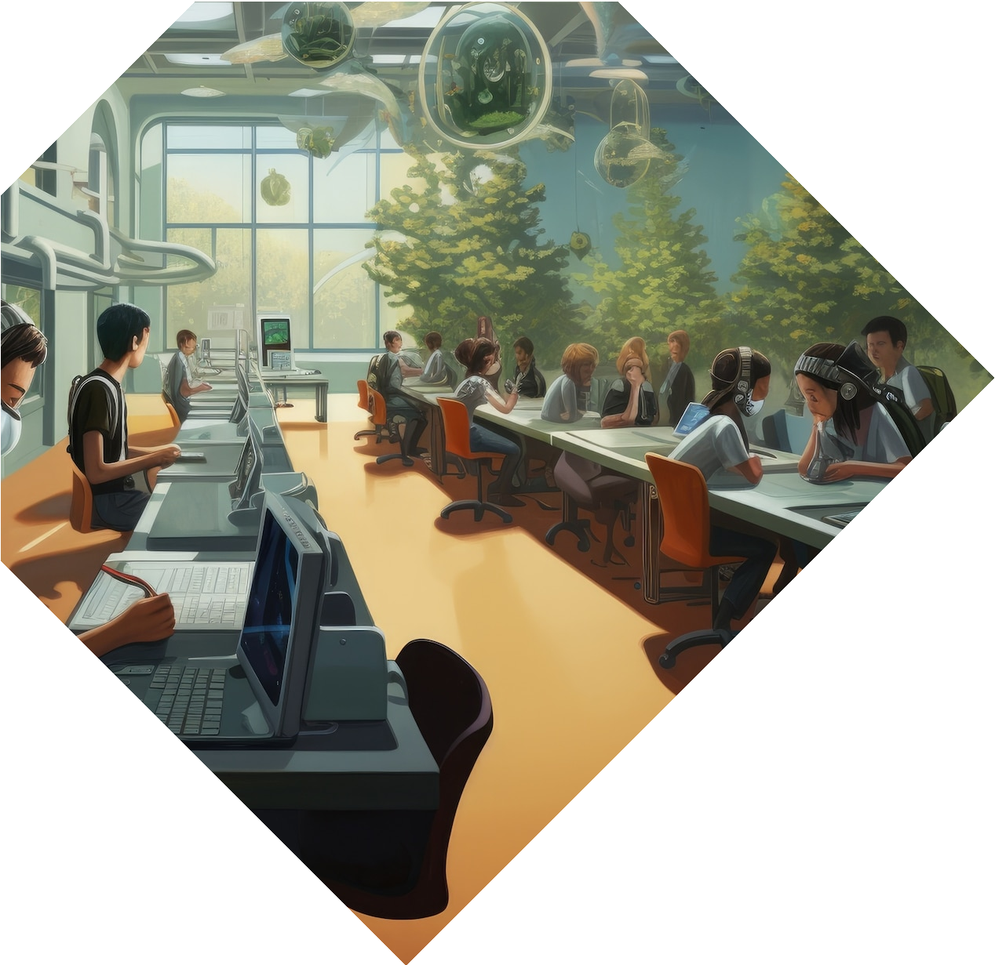

Implementation Plan
Conduct needs assessment to identify learning goals.
Develop personalized learning paths.
Establish Professional Learning communities.
Provide ongoing support and reflection
opportunities.

Slide 13
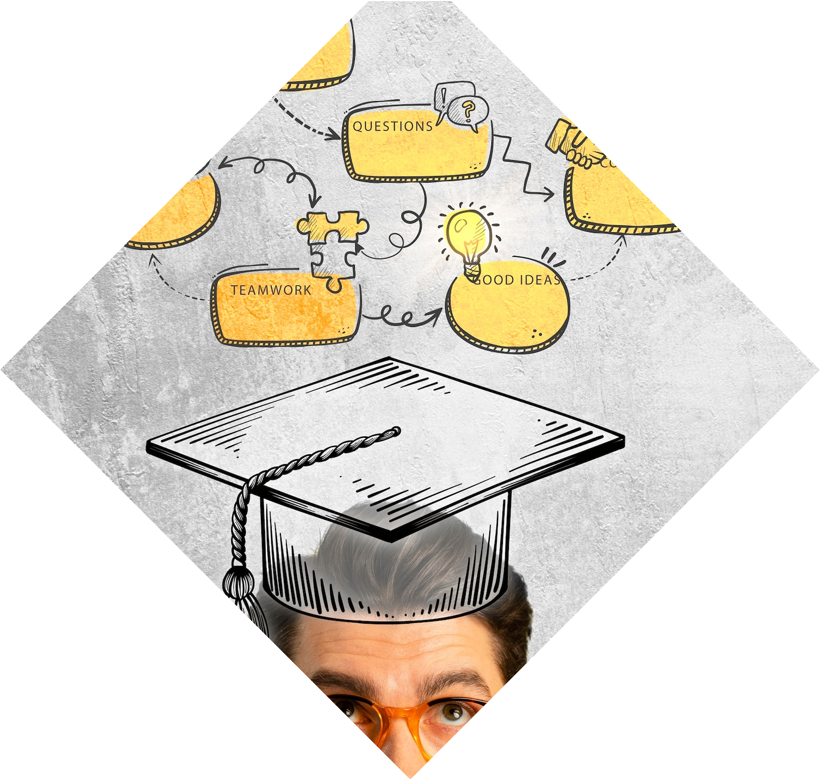
Conclusion
Embrace Professional Learning to unlock the potential of Blended Learning with Differentiation.
Collaborate for growth, innovation, and
impactful learning experiences.

